Slide 1


Brand Engagement: Social and digital perspective
Our way of making
our products reach
our customer's hands

Slide 2

Today's Agenda
Key takeaways:
What is Brand Engagement?
Why social brand engagement?
Social perspective of brand marketing
Digitalization affects on branding
Effective strategies

Slide 3






Brand Engagement
Brand engagement is the process of forming an emotional or rational attachment between a consumer and a brand. It comprises one aspect of brand management. Brand engagement will impact brand attachment and has a positive influence on customer purchase intentions

Slide 4


Why social brand engagement ?
From the mid 2000’s on, influential brand consultants and writers like Kevin Roberts and Marc Gobé began telling marketers that brand awareness and loyalty were not enough, that managers now needed to seek emotional commitment and brand love.
Scholars have expanded the engagement concept to include the active and social aspects of brand engagement, when a consumer begins to simultaneously interact with the brand and with other people.
Notes:
simple shbdo mein bata dena ki people will be able to relate with brands, participate with brands, associate themselves with brands which will ultimately help the brand and consumers

Slide 5

SOCIAL PERSPECTIVE
Businesses And Consumers Are
Driven By Emotions

Slide 6
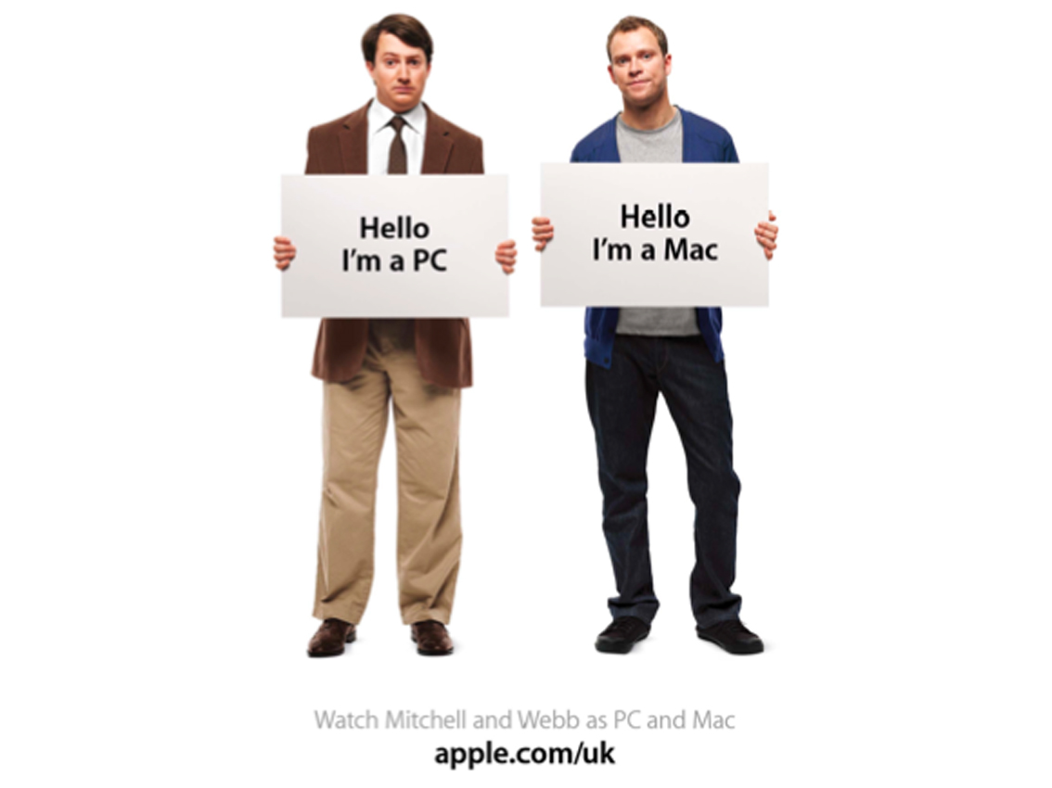
How Brands Form Identity
The “Get a Mac” campaign is an example of the use of identity in branding. Identity is an important psychological and social concept that relates to how we view and define ourselves and others
Notes:
its s good line to start
Apple launched its “Get a Mac” campaign. The campaign featured a series of commercials that started out with a young, hip guy in a hoodie introducing himself by saying “Hi, I’m a Mac.” A stodgy, older man wearing a blazer and glasses portrayed another computer brand. The campaign implied that the computer you use signifies the kind of person you are, and of course you want to be young and cool, like a Mac.

Slide 7


MAKING NATIONALISTIC APPEALS
Ultratech Cement.
Hitting Emotions by Social work
Kesh kaanti OIl

Slide 8
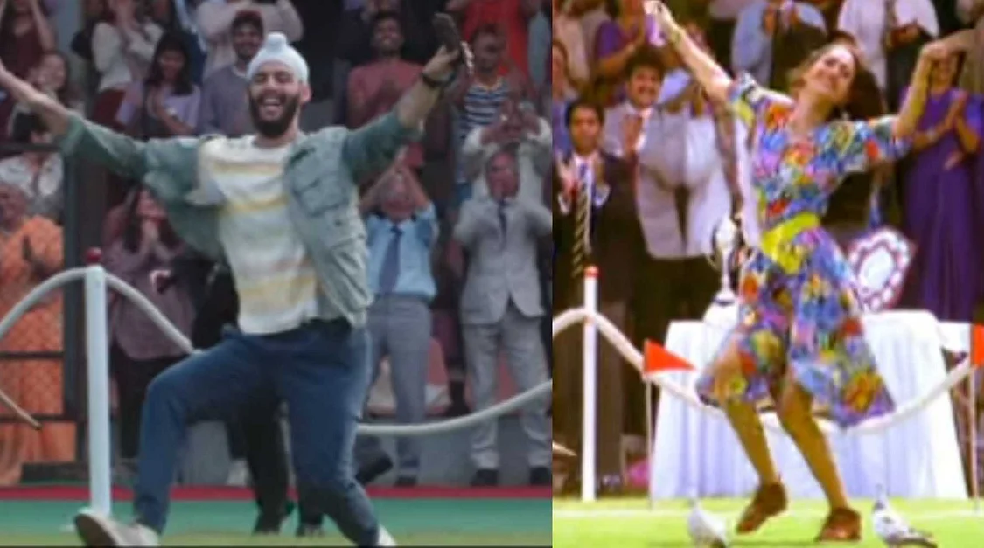
Bringing Social Change In Perspective
Notes:
intention was good
still their ad faced an enormous backlash from people becuase of claims of prmoting love jihad
had to pull it back

Slide 9

NEGATIVE IMPLICATIONS
NEGATIVE IMPLICATIONS

Slide 10
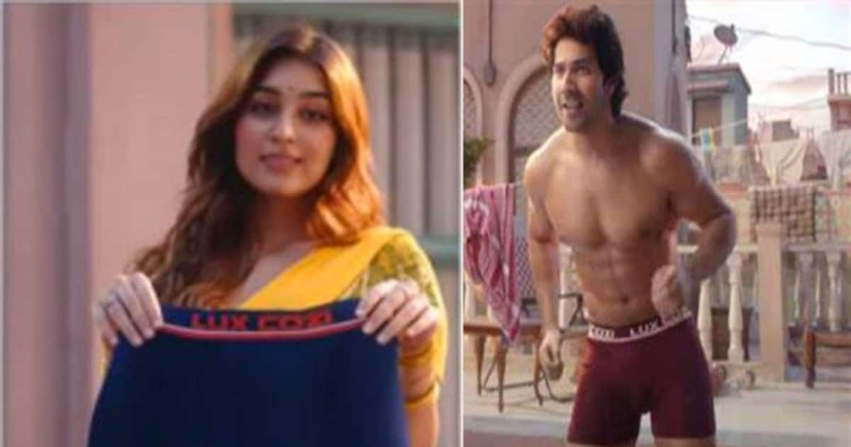

How Does the Generation Gap Affect Branding?
A
Reinforcing Popular Stereotypes
Notes:
while aiming to target certain audience they might offend other sections of audience( Lux Cozi__hr time rho cozi

Slide 11
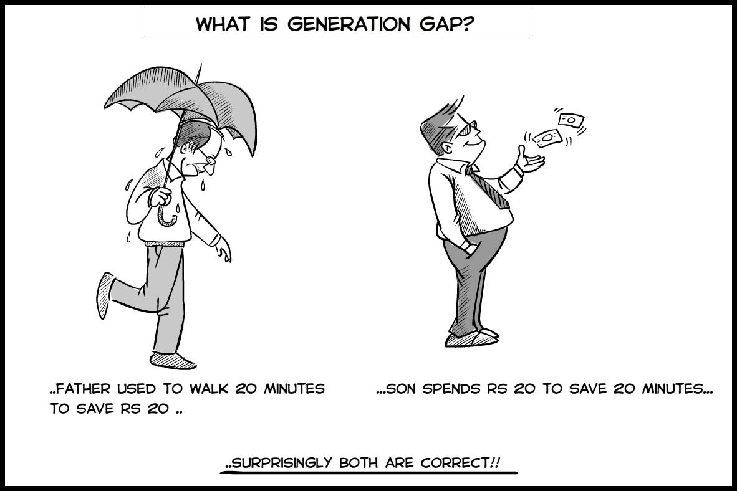
Gen Gap & Brand Engagement
 | Grand Father | Father | Son
Characteristics | *Joint Family *Save and pay by cash | *Nuclear Family *Save and pay by Debit card | *”Me Generation’” *Buy today pay later *Earn to spend
Technology | * Radio | *Television | *tech-savvy
Engagement Through | *Believes in shared experiences ; Friend &Family | *Newspaper , TV | *Online Reviews, Google Adv, Youtube Influecers

Slide 12

Digitalization affects on branding

Slide 13





Building Block of Brand & Banding has changed
To influence customer perception of your brand, your brand must be known. A brand awareness campaign is a great first step towards getting the word out about your unique business or organization.
Facebook
Instagram
Dollar shave club_1 Billion Dollar

Slide 14

Choice is outsourced by algorithms
Search Engine Optimisation
Nowadays, cloud computing is increasingly popular. As its important application, outsourcing has aroused great concern. Meanwhile, our algorithm allows outsourcers to detect any misbehavior with probability 1, which means the checkability of our algorithm shows a significant improvement in comparison to other single server based schemes. Furthermore, to protect data privacy, we propose a new division method to hide the primitive outsourced data. Compared with the state-of-the-art schemes, our secure outsourcing algorithm has an outstanding performance in both efficiency and checkability.

Slide 15



Making the most out of the internet
Social media channels
Automated
customer service
Take advantage of the tools available.
Seamless
ecommerce platform
Analytic tools
and reporting
Tailor-made user recommendations

Slide 16



Brand Discoverable
on a platform
75%
Social media marketing
Brands are investing in getting discovered on online platforms like Amazon, Flipkart etc
They have Social Media handling teams which handle’s and maintains there image in the market

Slide 17
Item 6
16.7%
Item 1
16.7%
Creating a bigger online presence
The different areas companies
focus on online
Item 5
16.7%
Item 2
16.7%
Brands are investing in getting discovered on online platforms like Amazon, Flipkart etc
They have Social Media handling teams which handle’s and maintains there image in the market
Item 4
16.7%
Item 3
16.7%

Slide 18
Adapt to different platforms
01
02
03
See how other
profiles are created
Gauge the audience's tastes and preferences
Build a profile apt for that specific platform
Having good social media profiles can get you more exposure online, help you connect with your fans or customers, and improve your online reputation.
In social media analytics, it’s part of the process to understand audiences by their taste. The taste, in this case, is reflected upon the interactions of the audiences to different “triggers.” The term “triggers,” in this case, can translate to many of the different data points we have in analytics.
Having good social media profiles can get you more exposure online, help you connect with your fans or customers, and improve your online reputation.

Slide 19
How brands work online
An example of an online schedule
Choosing photos
& creating designs
Writing
effective copy
Uploading
content
Connecting
with followers
Choosing testimonials
Make it your own by customizing it with text and photos.
Apply page animations and transitions to your Canva Presentation to emphasize ideas and make them even more memorable.
Find the magic and fun in presenting with Canva Presentations.
Designs should be Simple, mind gaging
Color schemes should also be chosen in sync with the product

Slide 20
How great brands deal with consumers
Interact with followers
Quick response
to inquiries
Swift order taking
and assistance
Presentations are communication tools that can be used as demonstrations and lectures.
It serves a variety of purposes,
making presentations powerful tools for convincing and teaching.
To create a stunning presentation,
it's best to simplify your thoughts. Remember to make it easy to read.
Swift order taking and assistance
Delivering on promises
Keeping the customers delighted
Make sure you do enough research to support your points. It’s also a good idea to use visual aids.
You can then organize them into your introduction, your main content, and your conclusion.
Avoid overloading a slide with too many words and choose a color palette that isn't distracting.

Slide 21


Our Team
1. Aman Kumar :- 20MIA1144
2. Aadi Ashutosh Chauhan :- 18BEE1007
3. Mayank Gupta :- 20BCE1538
4. Naveen Gupta :- 19BCE1791
5. Karan Dua :- 20BAI1012
6. Saikiran Reddy :- 18BEC1006

Slide 22
What we plan to do
Deep dive into social and digital perspective of brand engagement
How to implement social and digital brand engagement
Review 2 |  |  |  | Review 3
01
02
03
Case study of a brand engaging
Conclude the whole study

Slide 23


Effective marketing depends on what you say and how you say it.

